Slide 1
Resequencing and Variant Calling
Joshua Randall
Human Genetics Informatics
Wellcome Trust Sanger Institute
Thanks to Thomas Keane (WTSI Vertebrate Resequencing) for the use of his slides
Many more slides from Thomas can be found at: http://www.slideshare.net/thomaskeane

Slide 2
Resequencing and Variant Calling
Sequence Alignment
NGS Workflows
NGS Data Formats
SNP/indel Calling
Lab Exercises

Slide 3
Sequence Alignment
Sequence alignment in NGS is
Process of determining the most likely source within the reference genome sequence that the observed DNA sequencing read is derived from
Principles and approaches to sequence alignment have not changed
Basic Local Alignment Search Tool (BLAST)
‘Seed and extend’ approach
Query sequences vs. larger database of sequences
Split query sequences into short sequences (~10bp) and search for locations where these cluster in the larger database of sequences
Nucleotide blast, protein blast, blastx, tblastn, tblastx….
NGS: Nucleotide based alignment
Very small evolutionary distances (human-human, strains of the reference genome)
Allows for assumptions about the number of expected mismatches to speedup alignment programs
NGS has just massively scaled up a challenge that has existed since the inception of bioinformatics

Slide 4
Hash Table Based Alignment
All hash table based algorithms essentially follow the same seed-and-extend paradigm
K-mer is a short fixed sequence of nucleotides
Typical algorithm
Build a profile (index) of all possible k-mers of length n and the locations in the reference genome they occur
Several Gbytes in size for human genome
Foreach sequence read
Split into k-mers of length n
Lookup the locations in the reference via the index (seed phase)
Pick location on the genome with most k-mer hits
Perform Smith-Waterman alignment to fully align the read to the region
Output the alignment of each read onto the reference in BAM (or equivalent) format
Hash of the reads: MAQ, ELAND, ZOOM and SHRiMP
Smaller but more variable memory requirements
Hash the reference: SOAP, BFAST, MOSAIK, and SMALT
Advantage: constant memory cost

Slide 5


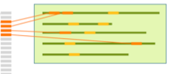
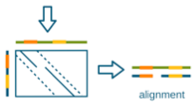
Hash Table Based Alignment
Sequencing reads
Kmer hash
Reference Genome

Slide 6
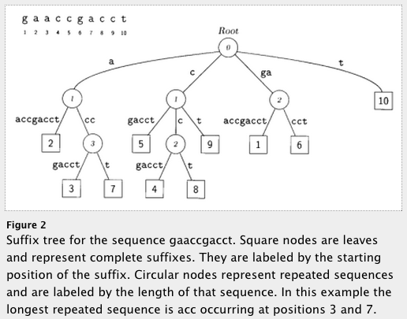
Suffix Trie/Array Based Aligners
Data structures to enable fast string matching
A suffix trie (or simply trie), is a data structure that stores all the suffixes of a string, enabling fast string matching (at the expense of space). A similar data structure is the FM-index, a suffix-array-like data structure based on a Burrows-Wheeler Transform (BWT) which is much more space efficient.
FM-Index based
Small memory footprint
Examples
MUMmer, BWA, bowtie
Still require a final step to generate local alignment
Delcher et al (1999) NAR
Notes:
needs work

Slide 7
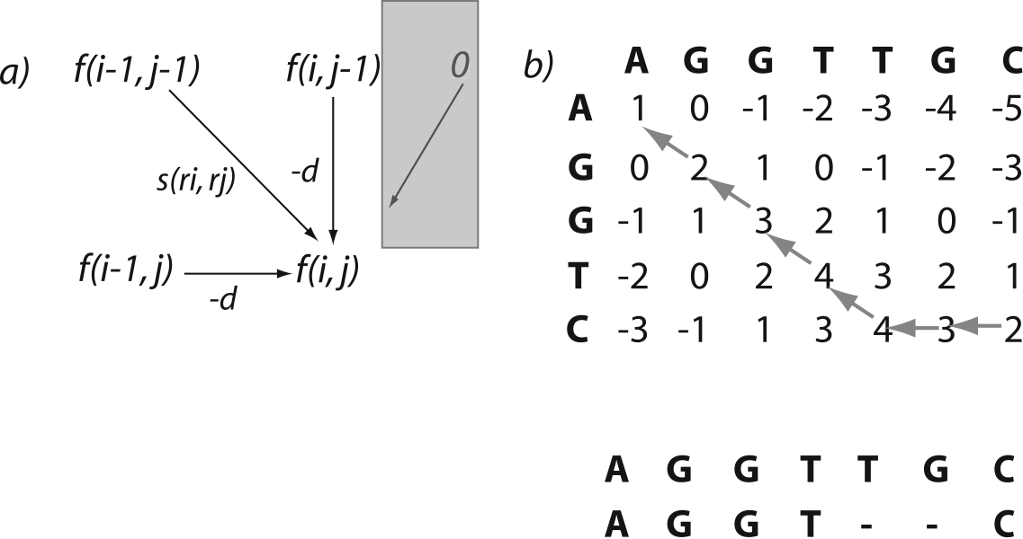
Smith-Waterman Algorithm
Algorithm for generating the optimal pairwise alignment between two sequences
Time consuming to carry out for every read
Only applied to a small subset of the reads that don’t have an exact match
Important for correctly aligning reads with insertions/deletions
Match: +1
Mismatch: 0
Gap open: -1
Notes:
Match/mismatch = +1
Indel = -1

Slide 8
Mapping Qualities
What if there are several possible places in the genome to align your sequencing read?
Genomes contain many different types of repeated sequences
Transposable elements (40-50% of vertebrate genomes)
Low complexity sequence
Reference errors and gaps
Mapping quality is a measure of how confident the aligner is that the read is corresponds to this location in the reference genome
Typically represented as a phred score (log scale)
Q10 = 1 in 10 incorrect
Q20 = 1 in 100 incorrect
Paired-end sequencing is useful
One end maps inside a repetitive elements and one outside in unique sequence
Then the combined mapping quality can still be high
Hence always do paired-end sequencing!

Slide 9
Alignment Limitations
Read Length and complexity of the genome
Very short reads difficult to align confidently to the genome
Low complexity genomes present difficulties
Malaria is 80% AT – lots of low complexity AT stretches
Alignment around indels
Next-gen alignments tend to accumulate false SNPs near true indel positions due to misalignment
Smith-Waterman scoring schemes generally penalise a SNP less than a gap open
New tools developed to do a second pass on a BAM and locally realign the reads around indels and ‘correct’ the read alignments
High density SNP regions
Seed and extend based aligners can have an upper limit on the number of consecutive SNPs in seed region of read (e.g. Maq – max of 2 mismatches in first 28bp of read)
BWT based aligners work best at low divergence

Slide 10
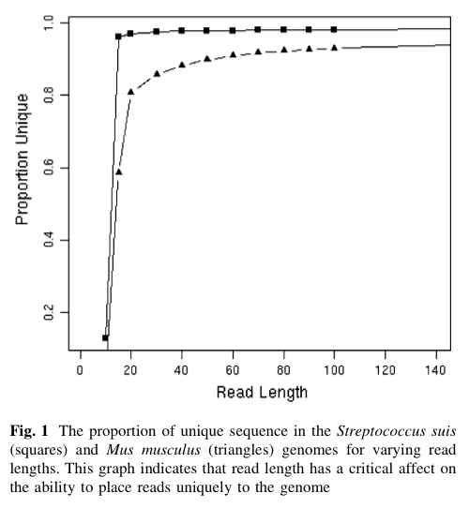
Read Length vs. uniqueness

Slide 11
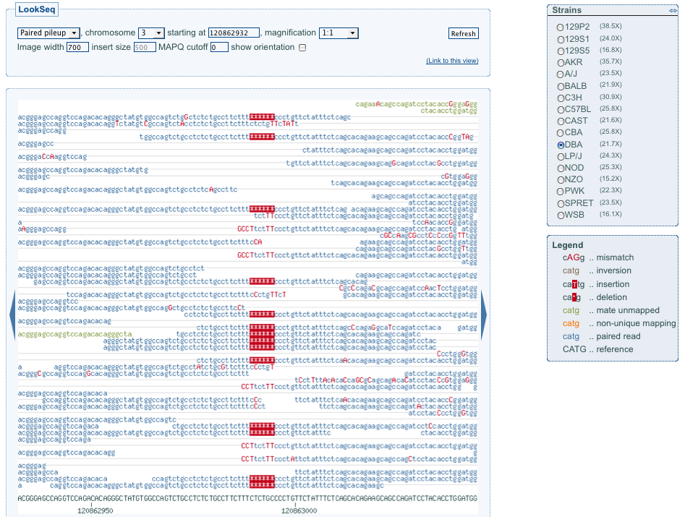
Example Indel

Slide 12
Using BWA
bwa index [-a bwtsw|div|is] [-c] <in.fasta>
-a STR BWT construction algorithm: bwtsw or is
bwtsw for human size genome, is for smaller genomes (div deprecated)
bwa aln [options] <prefix> <in.fq>
Align each single end fastq file individually
Various options to change the alignment parameters/scoring matrix/seed length
bwa sampe [options] <prefix> <in1.sai> <in2.sai> <in1.fq> <in2.fq>
sai files produced by aln step
Produces SAM output
bwa samse [-n max_occ] <prefix> <in.sai> <in.fq>
Unpaired reads – produces SAM output
Use samtools to manipulate SAM file or convert to BAM
samtools view –bS in.sam > out.bam

Slide 13
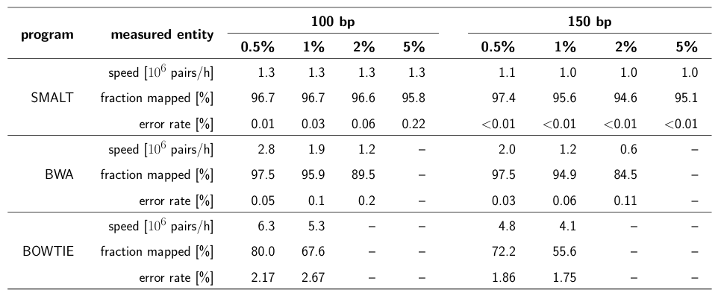
Using Smalt
Index the genome
smalt index -k 13 -s 6 hs37k13s6 NCBI37.fasta
Produces an kmer index of the genome
-k 13 speciﬁes the length, -s 6 the spacing of the hashed words
Align the reads
smalt map -i 800 hs37k13s6 mate_1.fastq mate_2.fastq

Slide 14
Parallelising Short Read Alignment
Aligning a single lane of reads can take a long time on a single computer
Simple parallelism by splitting the data
Split lane into 1Gbp chunks and align on different processors
BWA ~8 hours per 1Gbp chunk
Merge chunk BAM files back into single lane BAM
‘samtools merge’ command
Always check for truncated BAM files
Running ‘samtools index’ on your BAM file is the simplest way to check
(it will say ‘The input is probably truncated’ if it does not find the EOF marker)

Slide 15
QC Metrics from Alignments
Several useful metrics to check to assess the quality of your data and alignments produced
Number of reads mapped, bases mapped, duplicate fragments, reads w/adaptor, error rate, fragment size distribution, genotype check
Genotype check – is this the correct sample?
Use an external set of genotypes for the sample to assess the likelihood that the sample is the expected sample e.g. genotyping chip
Biases in sequencing
GC vs. depth
Indel ratio
Read cycle vs. base content

Slide 16
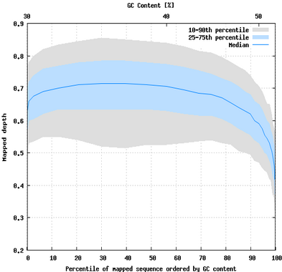
GC vs. Depth
Notes:
Premise for this plot: all positions of the genome should be sequenced equally regardless of sequence context e.g. GC %

Slide 17
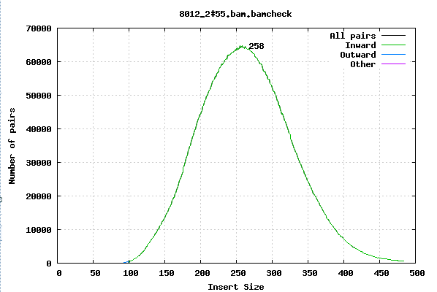
Fragment size
Notes:
Premise: in the library creation, a certain DNA fragment size was desired. What is the actual fragment size observed in the data?

Slide 18
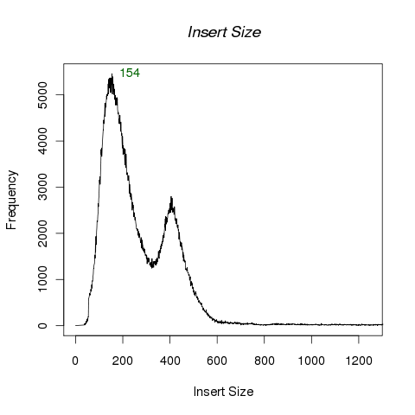
Fragment size

Slide 19
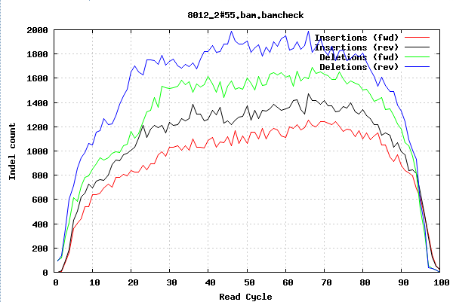
Indels per cycle
Notes:
Premise: Insertions and deletions should occur equally at any position in the reads.
Take all of the reads and just count at what position the indels are occurring in the reads

Slide 20
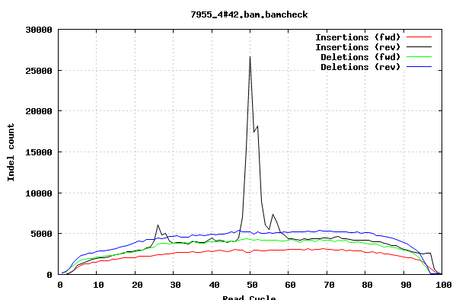
Indels per cycle

Slide 21
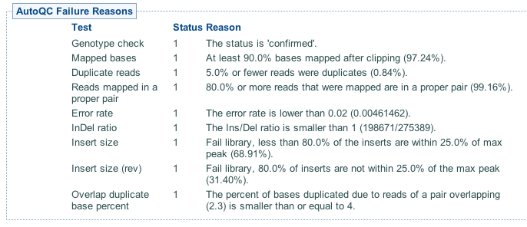
QC Metrics from Alignments

Slide 22
Reading and Links
Flicek and Birney (2009) Sense from sequence reads: methods for alignment and assembly, Nature Methods, 6, S6 - S12
Samtools: http://samtools.sourceforge.net/
BWA: http://bio-bwa.sourceforge.net/bwa.shtml
Smalt: http://www.sanger.ac.uk/resources/software/smalt/
Local realignment
http://www.broadinstitute.org/gsa/wiki/index.php/Local_realignment_around_indels

Slide 23
Resequencing and Variant Calling
Sequence Alignment
NGS Workflows
NGS Data Formats
SNP/indel Calling
Lab Exercises

Slide 24
NGS Workflows
Next-gen sequencing experiments
Several, tens or hundreds of samples
One or more sequencing libraries per sample
Sample could constitute several libraries
Reference based analysis or de novo assembly
How the data is processed can have consequences on quality of variant calling
Alignment of the reads onto the reference is just the first step
QC of data is very important for good calls
Biases in the library or sequence data will produce unexpected results or missed variant calls
E.g. GC biases
How the data is processed prior to variant calling is important
Certain computational steps that should be carried out to improve the quality of the data and alignments prior to calling
Mapping -> improvement -> merging -> variant calling

Slide 25
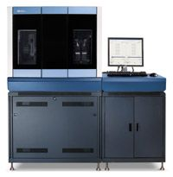
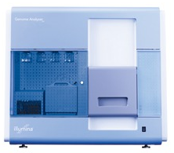
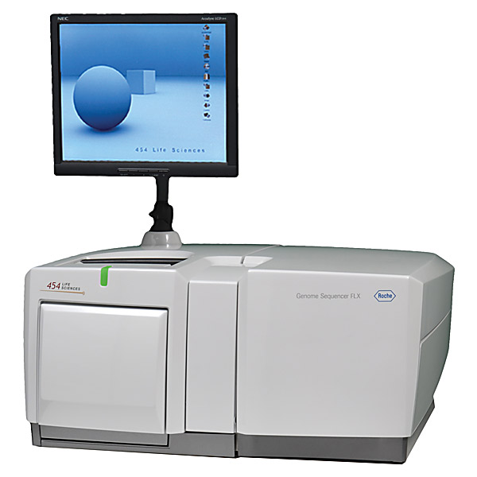
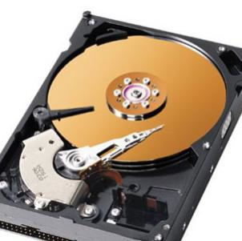

Data Production Workflow
Merge Up
Sample/Platform
Sample
merge
NA34842
NA87465
Library
merge
BAM
BAM
BAM
Library
Freeze
Import
+
Improvement
BAM
BAM
BAM
……
BAM
BAM
BAM
Improvement
BAM
BAM
BAM
……
BAM
BAM
Alignment
(bwa, smalt etc)
Fastq
Fastq
Fastq
……
Fastq
Fastq
Notes:
Now I will talk about the typical workflow used to process experiments involving large number of samples, libraries, lanes/plexes; prior to variant calling. We use this workflow to process 1000 genomes, UK10K, mouse sequencing….cancer sequencing etc.
Obtain sequencing data from the WTSI core facility and via disk shipments from the BGI.
BAM improvement: recalibration of base qualities and realignment around known indel sites

Slide 26
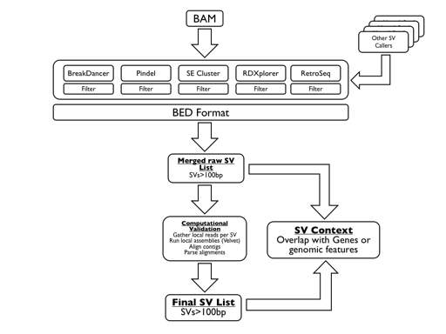
Data Production Workflow
Chr1
Chr2
Chr3
NA19294
NA18943
NA19305
.
.
NA19309
…
…
Merge
across
.
.
.
.
.
.
.
.
.
…
RG:NA19294
RG:NA18943
RG:NA19305
Cross-sample BAMs
SNPs/indels
SVMerge
Variant
Calling
samtools
GATK
Genome STRiP
VQSR
BEAGLE/Impute2
VEP Annotation
Final VCF ☺
Notes:
We have sample level BAM files – we could go straight to variant calling but as numbers of samples increased we had scaling issues with open huge number of BAM files simultaneously.
Merge across to create vertical chromosome BAMs (multiple samples per BAM per chromosome - ~100 samples)
-> reduce the number of file handles when doing variant calling
-> RG tags MUST be annotated
How variant callers are run obviously depends on the experiment

Slide 27
BAM Improvement
Lane level operation carried out after alignment
Input: BAM
Process 1: Local realignment
Process 2: Base quality recalibration
Output: (improved) BAM

Slide 28
Realignment
Short indels in the sample relative to the reference can pose difficulties for alignment programs
Indels occurring near the ends of the reads are often not aligned correctly
Excess of SNPs rather than introduce indel into alignment
Realignment algorithm
Input set of known indel sites and a BAM file
At each site, model the indel haplotype and the reference haplotype
Given the information on a known indel
Which scenario are the reads more likely to be derived from?
New BAM file produced with read cigar lines modified where indels have been introduced by the realignment process
Software
Implemented in GATK from Broad (IndelRealigner function)
What sites?
Previously published indel sites, dbSNP, 1000 genomes, generate a rough/high confidence indel set

Slide 29
Realignment

Slide 30

Base Quality Recalibration
Each base call has an associated base call quality
What is the chance that the base call is incorrect?
Illumina evidence: intensity values + cycle
Phred values (log scale)
Q10 = 1 in 10 chance of base call incorrect
Q20 = 1 in 100 chance of base call incorrect
Accurate base qualities essential measure in variant calling
Rule of thumb: Anything less than Q20 is not useful data
Illumina sequencing
Control lane or spiked control used to generate a quality calibration table
If no control – then use pre-computed calibration tables
Quality recalibration
1000 genomes project sequencing carried out on multiple platforms at multiple different sequencing centres
Are the quality values comparable across centres/platforms given they have all been calibrated using different methods?

Slide 31
Base Quality Recalibration
Original recalibration algorithm
Align subsample of reads from a lane to human reference
Exclude all known dbSNP+1000G pilot SNP sites
Assume all other mismatches are sequencing errors
Compute a new calibration table bases on mismatch rates per position on the read
Pre-calibration sequence reports Q25 base calls
After alignment - it may be that these bases actually mismatch the reference at a 1 in 100 rate, so are actually Q20
Recent improvements – GATK package
Reported/original quality score
The position within the read
The preceding and current nucleotide (sequencing chemistry effect) observed by the sequencing machine
Probability of mismatching the reference genome
NOTE: requires a reference genome and a catalog of variable sites

Slide 32
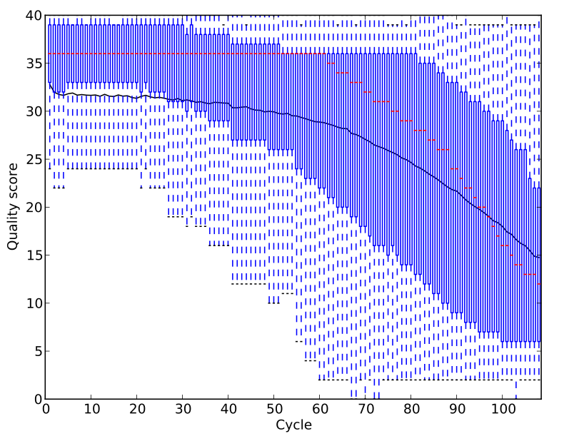
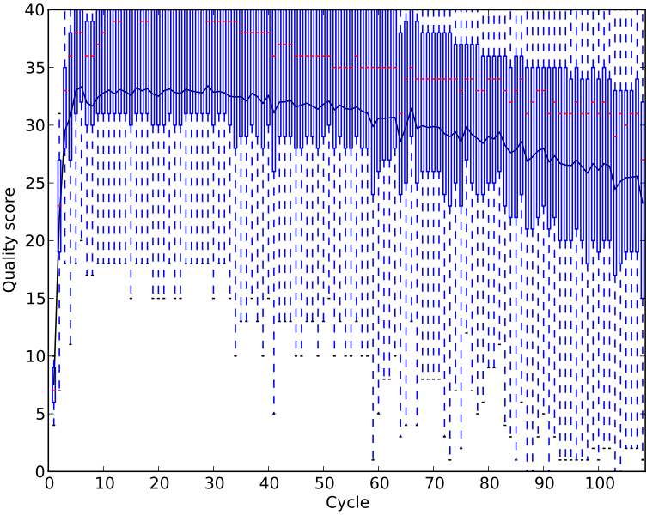
Base Quality Recalibration Effects

Slide 33
Data Production Workflow
Sample
merge
BAM
BAM
Sample/Platform
Library
merge
BAM
BAM
BAM
Library
BAM
BAM
BAM
BAM
BAM
BAM
Improvement
BAM
BAM
BAM
BAM
BAM
Lane/Plex
Alignment
(bwa, smalt etc)
Fastq
Fastq
Fastq
……
Fastq
Fastq

Slide 34
Library Merge
Library level operation carried out after BAM improvement
Input: Multiple Lane BAMs
Process 1: Merge BAMs (picard - MergeSamFiles)
Process 2: Duplicate fragment identification
Output: BAM

Slide 35
Library Duplicates
All second-gen sequencing platforms are NOT single molecule sequencing
PCR amplification step in library preparation
Can result in duplicate DNA fragments in the final library prep.
PCR-free protocols do exist – require larger volumes of input DNA
Generally low number of duplicates in good libraries (<5%)
Align reads to the reference genome
Identify read-pairs where the outer ends map to the same position on the genome and remove all but 1 copy
Samtools: samtools rmdup or samtools rmdupse
Picard/GATK: MarkDuplicates
Can result in false SNP calls
Duplicates manifest themselves as high read depth support

Slide 36
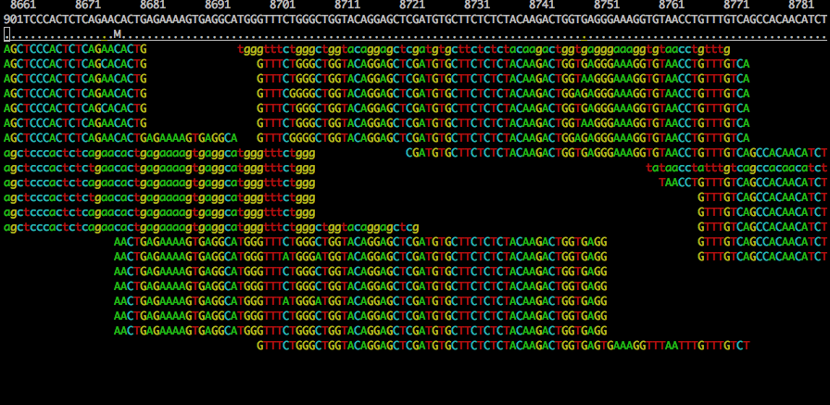
Duplicates and False SNPs
NA12005 - chr20:8660-8790

Slide 37
Software Tools
Alignment
BWA: http://bio-bwa.sourceforge.net/bwa.shtml
Smalt: http://www.sanger.ac.uk/resources/software/smalt/
Stampy: http://www.well.ox.ac.uk/project-stampy
BAM Improvement
Realignment (GATK): http://www.broadinstitute.org/gsa/wiki/index.php/Local_realignment_around_indels
Recalibration: http://www.broadinstitute.org/gsa/wiki/index.php/Variant_quality_score_recalibration
Library Merging
BAM Merging (Picard): http://picard.sourceforge.net/command-line-overview.shtml#MergeSamFiles
Duplicate Marking/removal (Picard): http://picard.sourceforge.net/command-line-overview.shtml#MarkDuplicates

Slide 38
Resequencing and Variant Calling
Sequence Alignment
NGS Workflows
NGS Data Formats
SNP/indel Calling
Lab Exercises

Slide 39
Primary NGS Data Formats
FASTA
Unaligned sequence data (in NGS context, used only for reference data)
FASTQ
Unaligned read sequences with base qualities
BAM
Aligned or unaligned reads
Text and binary formats
CRAM
Aligned or unaligned reads
Advanced compression models
VCF
Flexible variant call format
Arbitrary types of sequence variation

Slide 40
FASTA
FASTA is a simple format for raw sequencing data
In NGS workflows, typically only used for reference data
File extension is normally .fasta or .fa
Format
File can contain any number of sequence sections
Each sequence starts with a single-line description beginning with the ‘>’ character
Following this come any number of lines consisting of sequence data which when concatenated together gives the full sequence
Cock et al. (2009) NAR

Slide 41
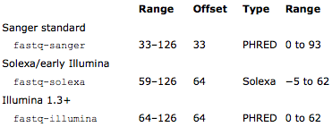
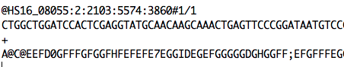
FASTQ
FASTQ is a simple format for raw unaligned sequencing reads
Simple addition to the FASTA format
Sequence and an associated per base quality score
Originally standard for storing capillary data
Format
Subset of the ASCII printable characters
ASCII 33–126 inclusive with a simple offset mapping
perl -w -e "print ( unpack( 'C', '%' ) - 33 );”
Cock et al. (2009) NAR

Slide 42
SAM/BAM Format
SAM (Sequence Alignment/Map) format
Single unified format for storing read alignments to a reference genome
BAM (Binary Alignment/Map) format
Binary equivalent of SAM
Developed for fast processing/indexing
Advantages
Can store alignments from most aligners
Supports multiple sequencing technologies
Supports indexing for quick retrieval/viewing
Compact size (e.g. 112Gbp Illumina = 116Gbytes disk space)
Reads can be grouped into logical groups e.g. lanes, libraries, samples
Widely support by variant calling software packages
Replacement to SRF & FASTQ

Slide 43
Read Entries in SAM
No. Name Description
1 QNAME Query NAME of the read or the read pair
2 FLAG Bitwise FLAG (pairing, strand, mate strand, etc.)
3 RNAME Reference sequence NAME
4 POS 1-Based leftmost POSition of clipped alignment
5 MAPQ MAPping Quality (Phred-scaled)
6 CIGAR Extended CIGAR string (operations: MIDNSHP)
7 MRNM Mate Reference NaMe (‘=’ if same as RNAME)
8 MPOS 1-Based leftmost Mate POSition
9 ISIZE Inferred Insert SIZE
10 SEQ Query SEQuence on the same strand as the reference
11 QUAL Query QUALity (ASCII-33=Phred base quality)
HS18_07983:1:2203:5095:109107#36 163 ENA|AJ011856|AJ011856.1 412 60 100M = 471 159
ATAAAATTATTAATAATAATCAATATGAAATTAATAAAAATCTTATAAAAAAGTAATGAATACTCCTTTTTAAAAATAAAAAGGGGTTCGGTCCCCCCCC
9BCDGDEHGEHFHHGFHHJGHFHIGHFIGHFHGGGHGHGHGHJGHHGHHHGGHHHIGGGGGFGGDGGHFHFIGEGHGFGGHFEDGG4GHGGGFHGFHIEF
X0:i:1 X1:i:0 MD:Z:100 RG:Z:1#36.1
Heng Li et al (2009) The Sequence Alignment/Map format and SAMtools, Bioinformatics, 25:2078-2079

Slide 44
Cigar Format
Cigar has been traditionally used as a compact way to represent a sequence alignment
Operations include
M - match or mismatch
I - insertion
D - deletion
SAM extends these to include
S - soft clip (ignore these bases)
H - hard clip (ignore and remove these bases)
E.g. Read: ACGCA-TGCAGTtagacgt
Ref: ACTCAGTG—-GT
Cigar: 5M1D2M2I2M7S

Slide 45
What is the cigar line?
E.g. Read: tgtcgtcACGCATG---CAGTtagacgt
Ref: ACGCATGCGGCAGT
Cigar:
Notes:
7S7M3D4M7S

Slide 46
Read Group Tag
Each lane has a unique RG tag that contains meta-data for the lane
RG tags
ID: SRR/ERR number
PL: Sequencing platform
PU: Run name
LB: Library name
PI: Insert fragment size
SM: Individual
CN: Sequencing center

Slide 47
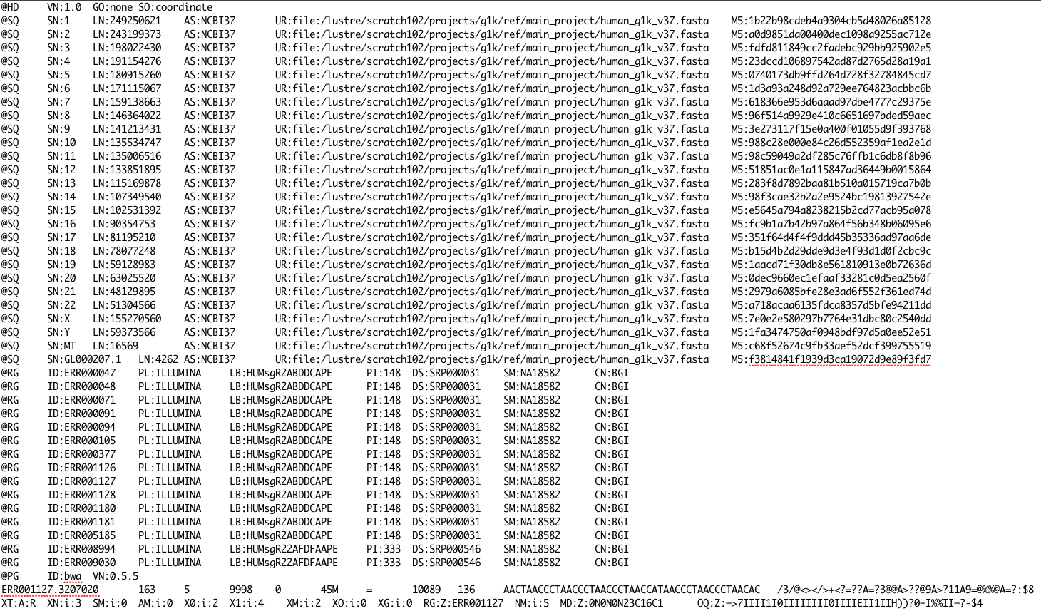
1000 Genomes BAM File
samtools view –h mybam.bam | less -S

Slide 48
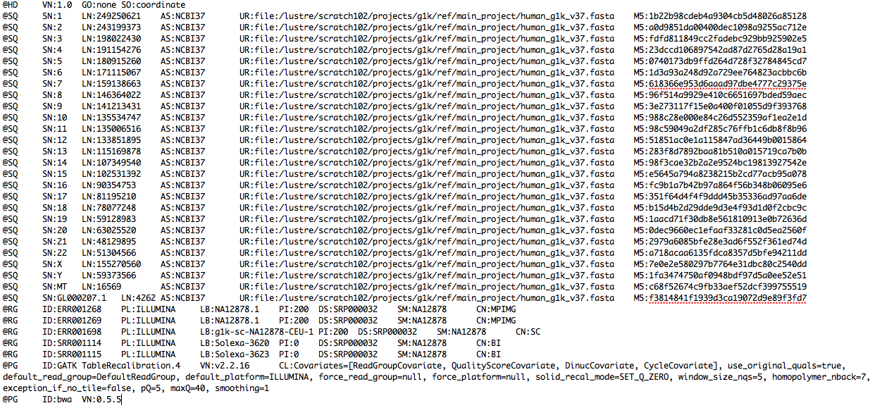
1000 Genomes BAM File
samtools view –H my.bam | less -S
How is the BAM file sorted? How many different sequencing centres contributed lanes to this BAM file? What is the alignment tool used to create this BAM file?
How many different sequencing libraries are there in this BAM? Hint: RG tag

Slide 49
SAM/BAM Tools
Several tools and programming APIs for interacting with SAM/BAM files
Samtools - Sanger/C (http://samtools.sourceforge.net)
Convert SAM <-> BAM (samtools view)
Sort and index BAM files (samtools sort, samtools index)
Give summary of the mapping flags (samtools flagstat)
Merge multiple sorted BAM files (samtools merge)
Remove PCR duplicates from the library preparation (samtools rmdup)
Picard - Broad Institute/Java (http://picard.sourceforge.net)
MarkDuplicates, CollectAlignmentSummaryMetrics, CreateSequenceDictionary, SamToFastq, MeanQualityByCycle, FixMateInformation, … (and many others)
Bio-SamTool – Perl (http://search.cpan.org/~lds/Bio-SamTools/)
Pysam – Python (http://code.google.com/p/pysam/)
BAM Visualisation
BamView, LookSeq, Gap5: http://www.sanger.ac.uk/Software
IGV: http://www.broadinstitute.org/igv/
Tablet: http://bioinf.scri.ac.uk/tablet/

Slide 50
CRAM
BAM files are too large
~1.5-2 bytes per base pair (12-16 bits/bp)
Increases in disk capacity are being far outstripped by sequencing technologies
BAM stored all of the data
every read base
every base quality
using conventional compression techniques
CRAM: Two important concepts
Reference based compression
Controlled loss of quality information
Widely seen as the sequencing format of the future

Slide 51
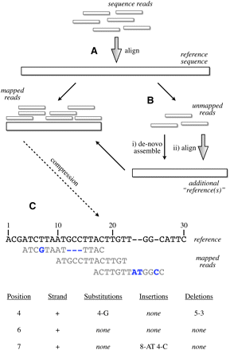
Reference Based Compression
Fritz et al. (2012) Gen Res
Notes:
Figure 1.
Schematic of the compression technique. (A) Reads are first aligned to an established reference. (B) Unaligned reads are then pooled to create a specific “compression framework” for this data set. (C) The base pair information is then stored using specific offsets of reads on the reference, with substitutions, insertions, or deletions encoded in separate data structures.

Slide 52
CRAM: Reference-based sequence data compression
TGAGCTCTAAGTACC
329183050298757
CRAM models for compression
TGAGCTCTAAGTACC
TGAGCTCTAAGTACC
002020010022212
-2---30---9---7
Do nothing
Lossless
Horizontal
Vertical
Quality lossy
Bits/base
CRAM current performance
Untreated
CRAM lossless
CRAM combination model
CRAM substitutions/insertions model
CRAM v0.9 released 03.08.12:
Pairing information preservation regardless of distance
Revised and improved lossless mode
Option to preserve all unmapped reads
Performance and bug fixes
Arbitrary tags
http://www.ebi.ac.uk/ena/about/cram_toolkit
http://listserver.ebi.ac.uk/mailman/listinfo/cram-dev
52
15/10/2013
European Nucleotide Archive

Slide 53
Variant Call Format (VCF)
VCF is a standardised format for storing DNA polymorphism data
SNPs, insertions, deletions and structural variants
With rich annotations
Can be indexed for fast data retrieval of variants from a range of positions
Store variant information across many samples
Record meta-data about the site
dbSNP accession, filter status, validation status
Very flexible format
Arbitrary tags can be introduced to describe new types of variants
No two VCF files are necessarily the same
User extensible annotation fields supported
Same event can be expressed in multiple ways by including different numbers
Recommendation on VCF format website to ensure consistency

Slide 54
VCF file structure
Header section and a data section
Header
Arbitrary number of meta-information lines
Starting with characters ‘##’
Column definition line starts with single ‘#’
Mandatory columns
Chromosome (CHROM)
Position of the start of the variant (POS)
Unique identifiers of the variant (ID)
Reference allele (REF)
Comma separated list of alternate non-reference alleles (ALT)
Phred-scaled quality score (QUAL)
Site filtering information (FILTER)
User extensible annotation (INFO)

Slide 55
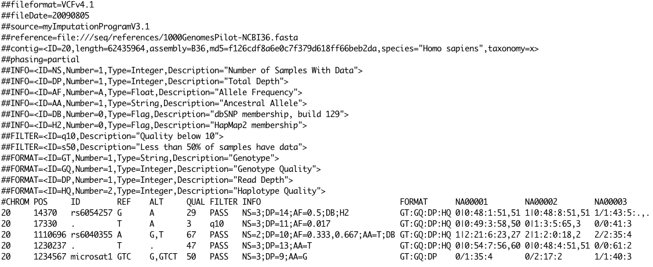
Example VCF – SNPs/indels
Notes:
This example shows in order a good simple SNP, a possible SNP that has been filtered out because its quality is below 10, a site at which two alternate alleles are called, with one of them (T) being ancestral (possibly a reference sequencing error), a site that is called monomorphic reference (i.e. with no alternate alleles), and a microsatellite with two alternative alleles, one a deletion of 2 bases (TC), and the other an insertion of one base (T). Genotype data are given for three samples, two of which are phased and the third unphased, with per sample genotype quality, depth and haplotype qualities (the latter only for the phased samples) given as well as the genotypes. The microsatellite calls are unphased.

Slide 56
VCF Trivia
What version of the human reference genome was used?
What does the DB INFO tag stand for?
What does the ALT column contain?
At position 17330, what is the total depth? What is the depth for sample NA00002?
At position 17330, what is the genotype of NA00002?
Which position is a tri-allelic SNP site?
What sort of variant is at position 1234567? What is the genotype of NA00002?

Slide 57
More information
VCF
http://bioinformatics.oxfordjournals.org/content/27/15/2156.full
http://www.1000genomes.org/wiki/Analysis/Variant%20Call%20Format/vcf-variant-call-format-version-41
VCFTools
http://vcftools.sourceforge.net/

Slide 58
Resequencing and Variant Calling
Sequence Alignment
NGS Workflows
NGS Data Formats
SNP/indel Calling
Lab Exercises

Slide 59
SNP Calling
SNP – single nucleotide polymorphisms
Examine the bases aligned to position and look for differences
SNP discovery
Finding new variant sites
SNP genotyping
Determining the genotype at a set of already known sites
Homozygous vs heterozygous SNPs
Factors to consider when calling SNPs
Base call qualities of each supporting base
Proximity to
Small indel
Homopolymer run (>4-5bp for 454 and >10bp for illumina)
Mapping qualities of the reads supporting the SNP
Low mapping qualities indicates repetitive sequence
Read length
Possible to align reads with high confidence to larger portion of the genome with longer reads
Paired reads
Sequencing depth
Few individuals/strains at high coverage vs. low coverage many individuals/strains
1000 genomes is low coverage sequencing across many individuals
Population based SNP calling methods

Slide 60
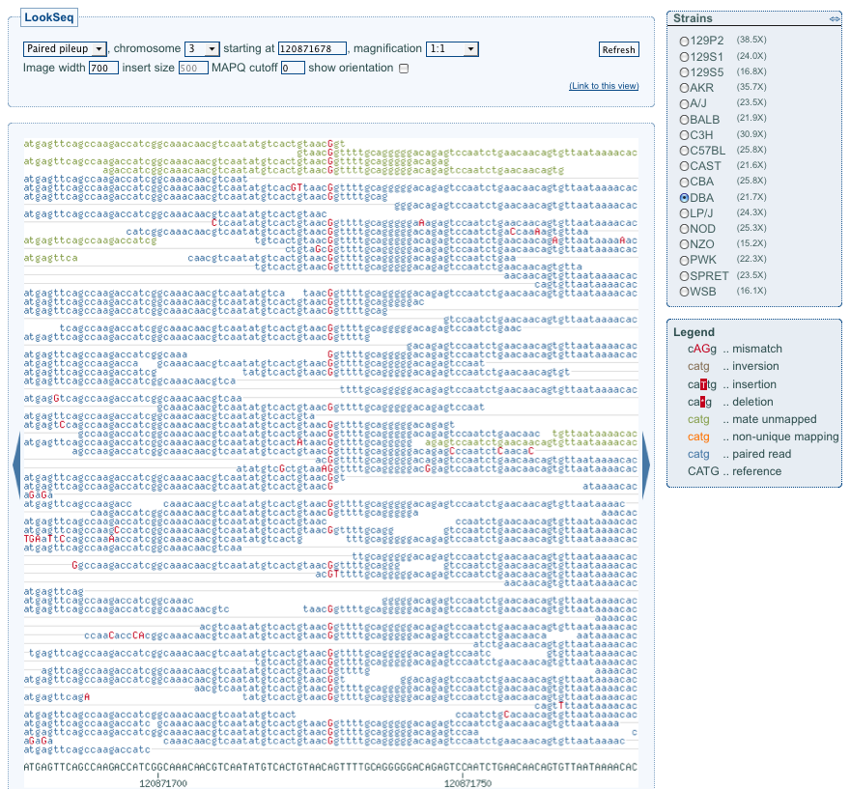
Mouse SNP

Slide 61
Read Length vs. uniqueness

Slide 62
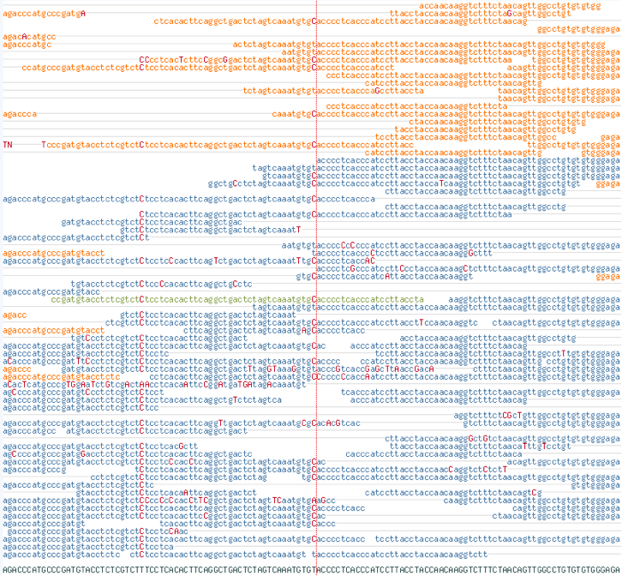
Is this a SNP?

Slide 63
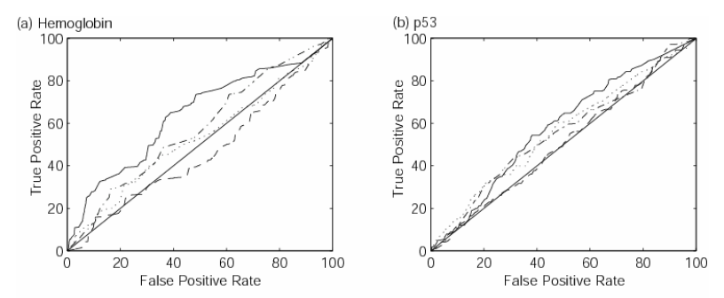
Evaluating SNPs
Specificity vs sensitivity
False positives vs. false negatives
Desirable to have high sensitivity and specificity
Sensitivity
External sources of validation
Specificity
Test a random selection of snps by another technology
e.g. Sequenom, Sanger sequencing…
Receiver operator curves to investigate effects of varying parameters

Slide 64
Known Systematic Biases
Many biases can be introduced in either sample preparation, sequencing process, computational alignment steps etc.
Can generate false positive SNPs/indels
Potential biases
Strand bias
End distance bias
Consistency across replicates/libraries
Variant distance bias
VCF Tools (vcf-annotate)
Soft filter variants file for these biases
Variants kept in the file – just annotated with potential bias affecting the variant

Slide 65
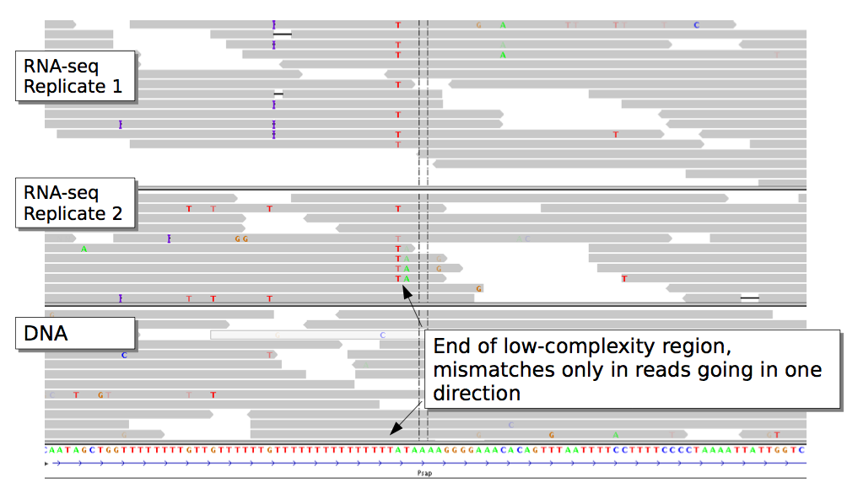
Strand Bias

Slide 66
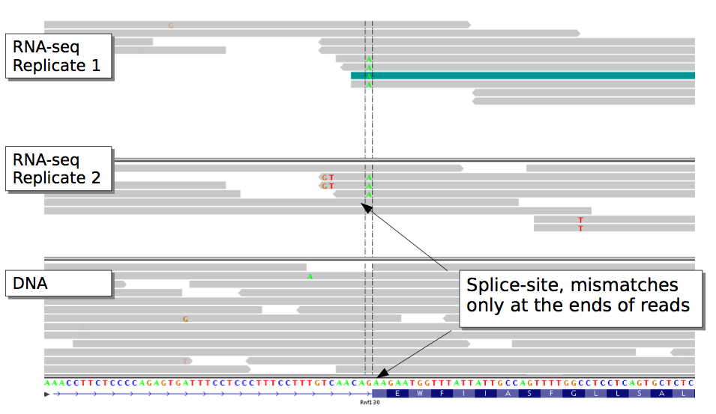
End Distance Bias

Slide 67
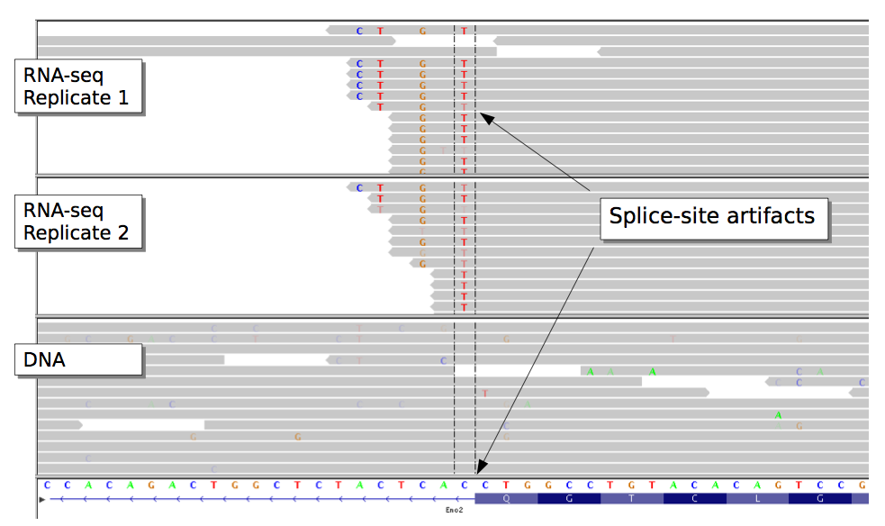
Variant Distance Bias
Notes:
VDB (variant distance bias) checks if variant bases occur at random positions in the aligned portion of the reads.

Slide 68
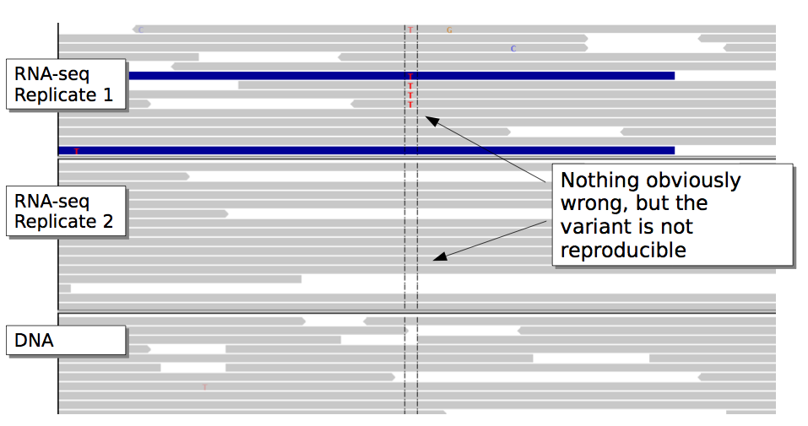
Reproducibility

Slide 69
Resequencing and Variant Calling
Sequence Alignment
NGS Workflows
NGS Data Formats
SNP/indel Calling
Lab Exercises

